Slide 1





GREEN TAXI - NYC DATAWAREHOUSE SOLUTION
Group 6:
- Nivetha Sivakumar
- Vidhika jain
- Akshay Nalawade
- Ashish Rogannagari

Slide 2
Identified problem
PERSON OF INTEREST - GREEN TAXI ANALYTICS MANAGER
Lack of a consolidated system for performance monitoring.
Data sourced from disparate sources, hindering integration.
Absence of a dedicated system to store historical data.
Slowed-down processes for the business intelligence team due to these limitations.

Slide 3

Our solution
Our proposed solution incorporates the following advancements:
Leveraging AWS as our cloud partner to facilitate a scalable, cost-effective, and reliable solution.
Implementing reusable data extraction, cleaning, and preparation methods to ensure suitability for live data.
Establishing a Data Warehouse that seamlessly integrates weather data with green taxi operations in NYC.

Slide 4
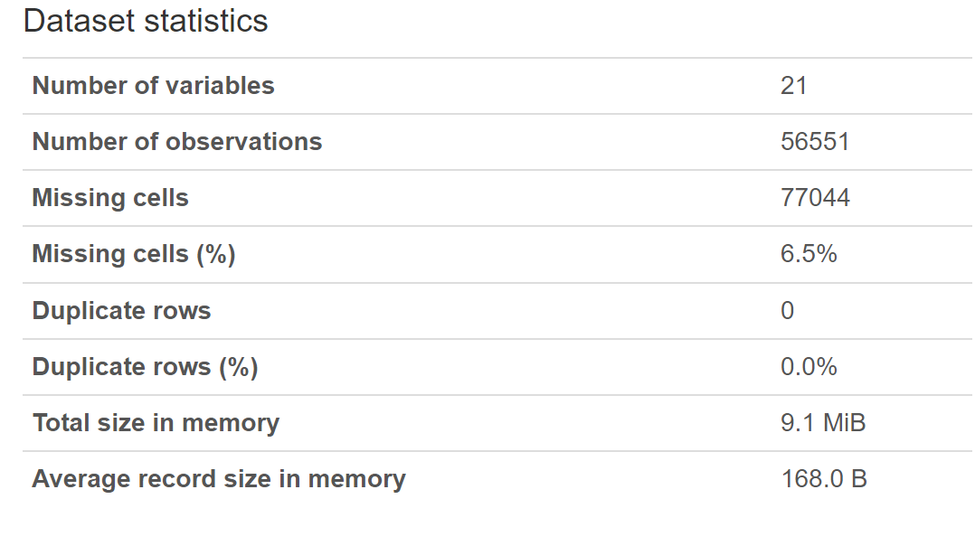
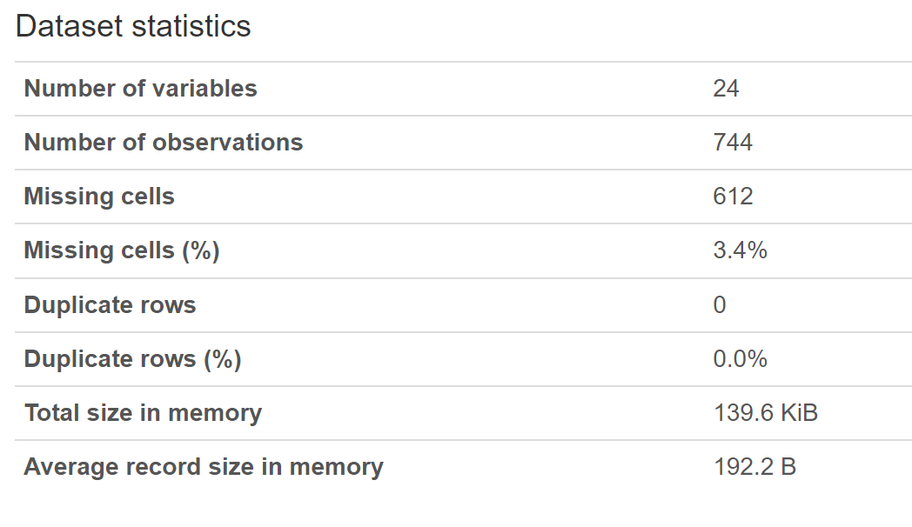
dATA profile
Dataset 1
Dataset 2
Data : green taxi data
Source: NYC.gov
Format: CSV
link
Data: Weather data
Source: weatherAPI
Format: API
LINK

Slide 5
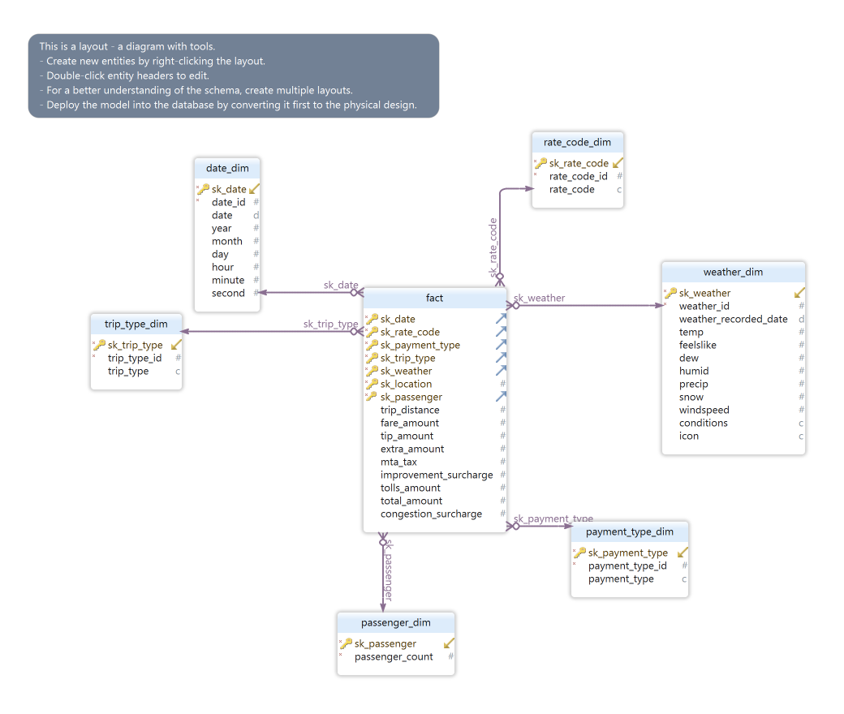
OLAP STRUCTURE
The schema depicts a star schema.
The dimension tables include date_dim, rate_code_dim, trip_type_dim, weather_dim, payment_type_dim, and passenger_dim.
The fact table contains information about the trip distance, Different charges.

Slide 6
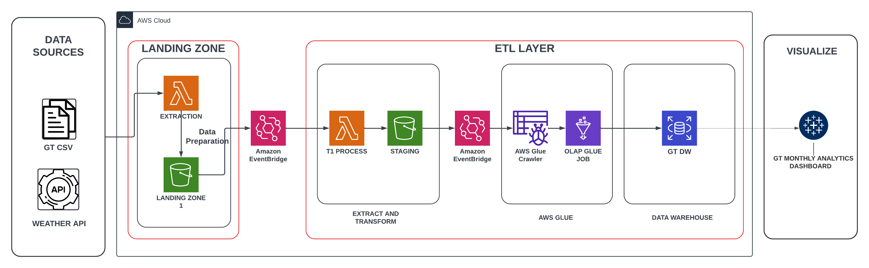
AWS Architecture

Slide 7
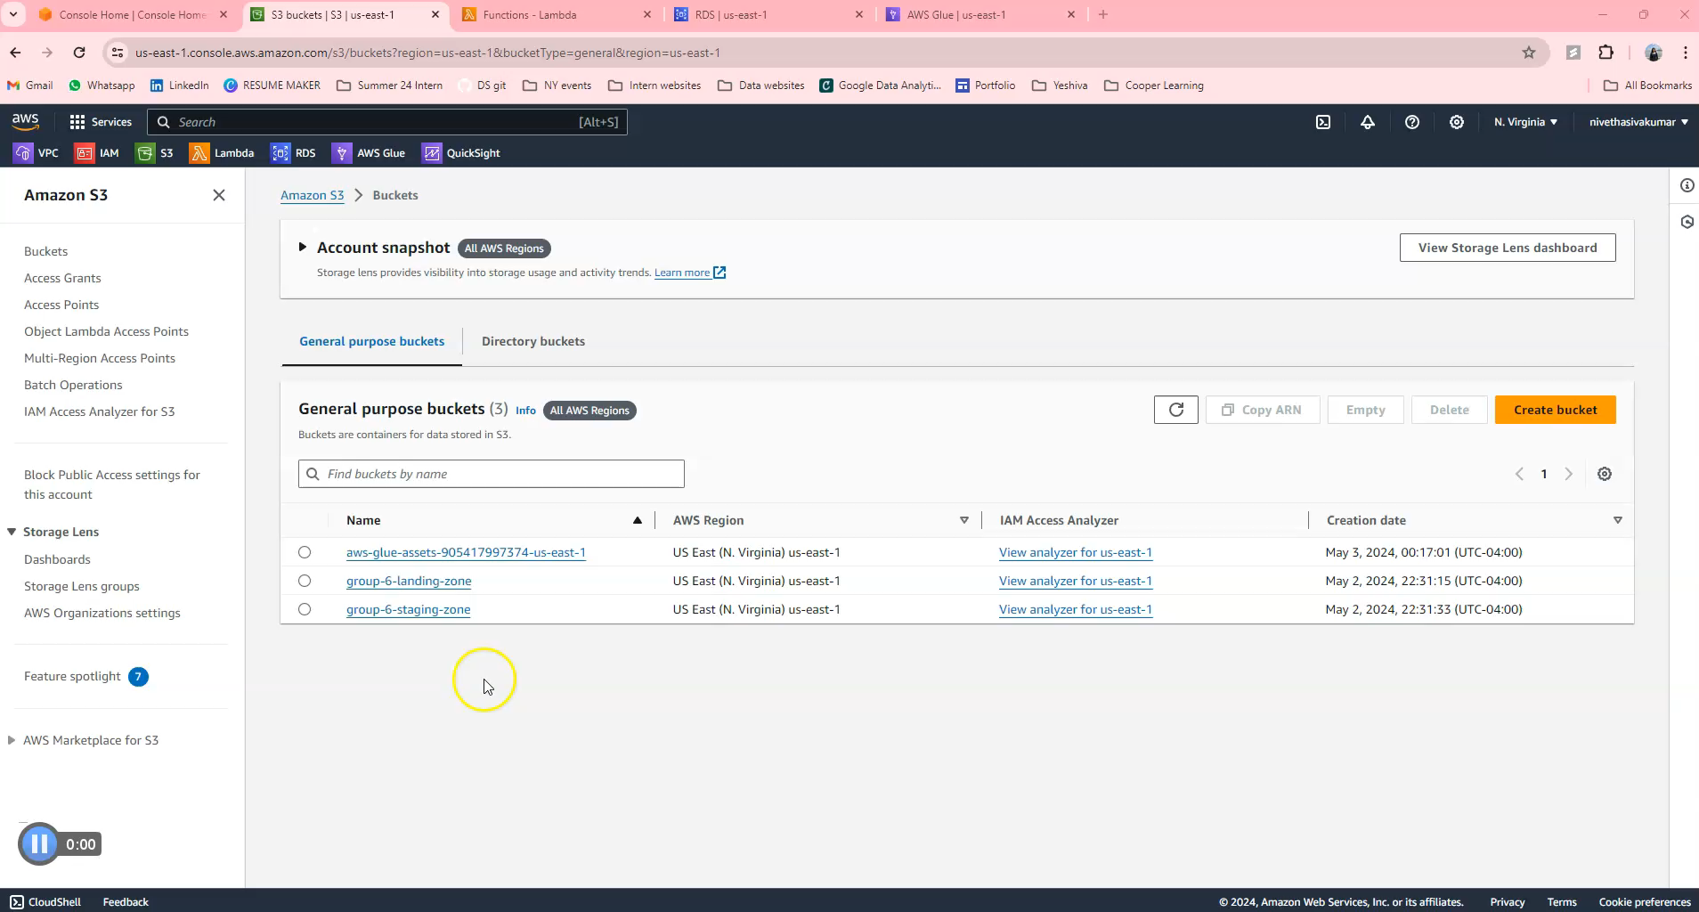
AWS END TO END DEMO

Slide 8
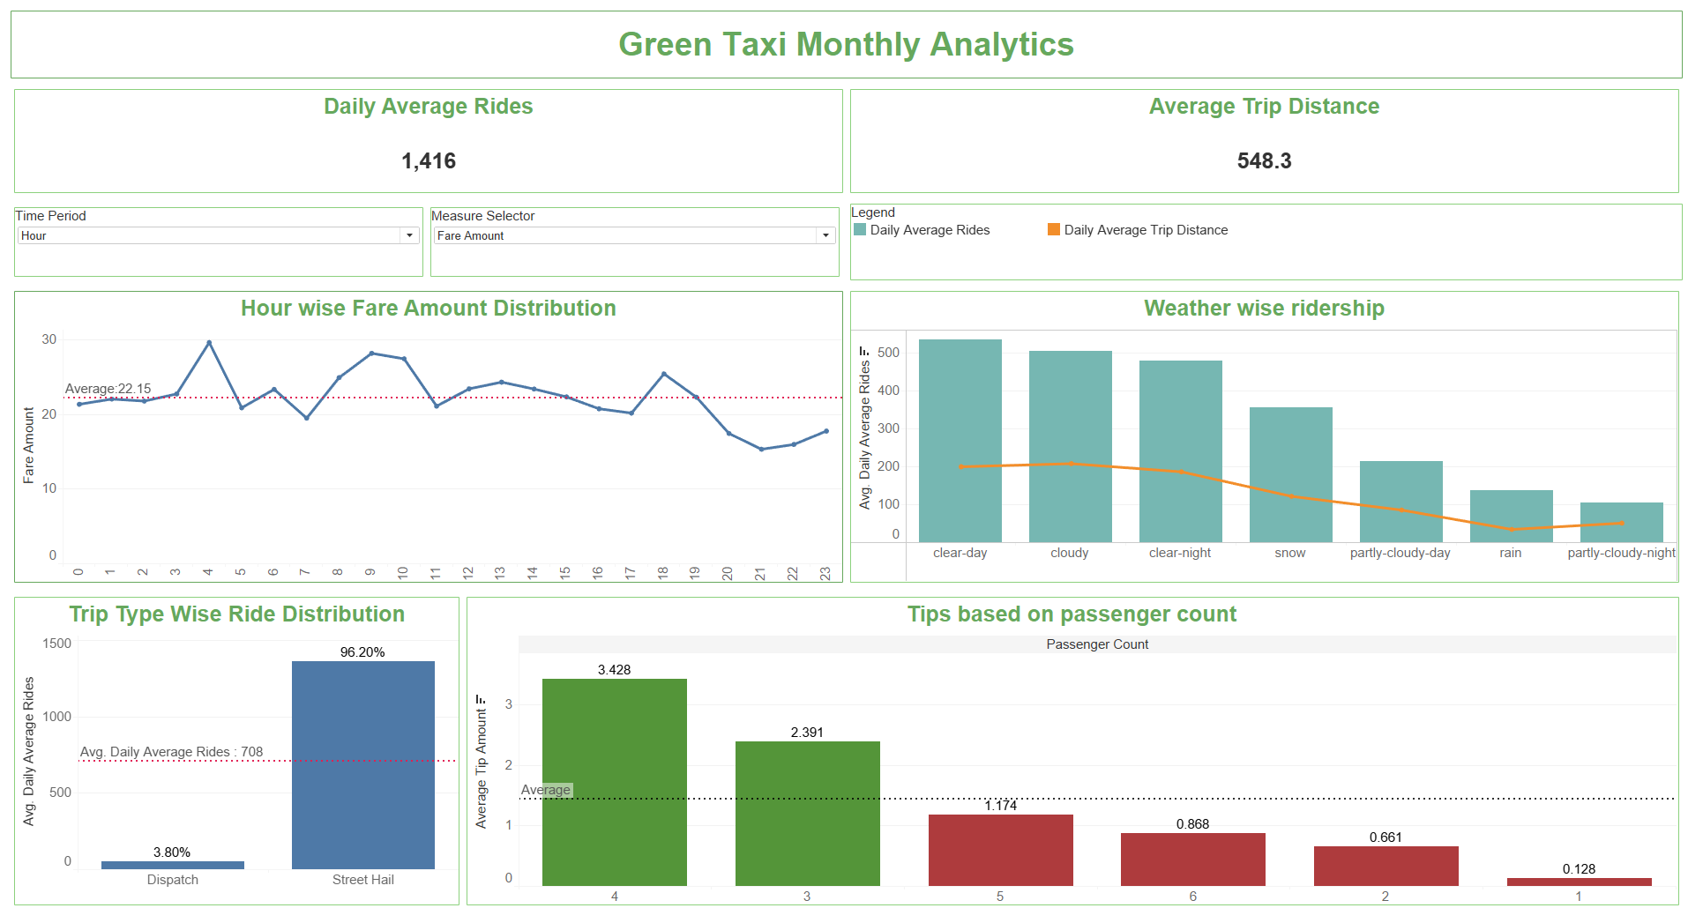
Dashboard

Slide 9
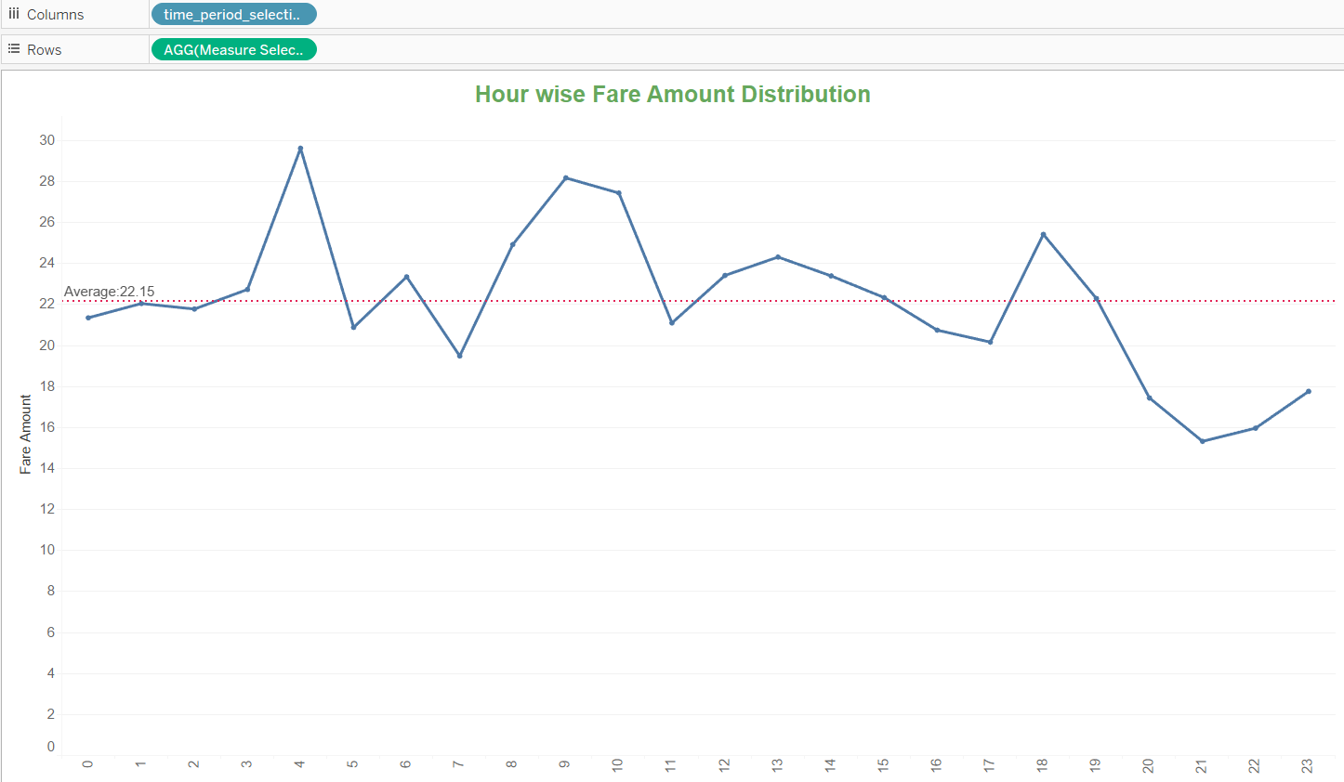
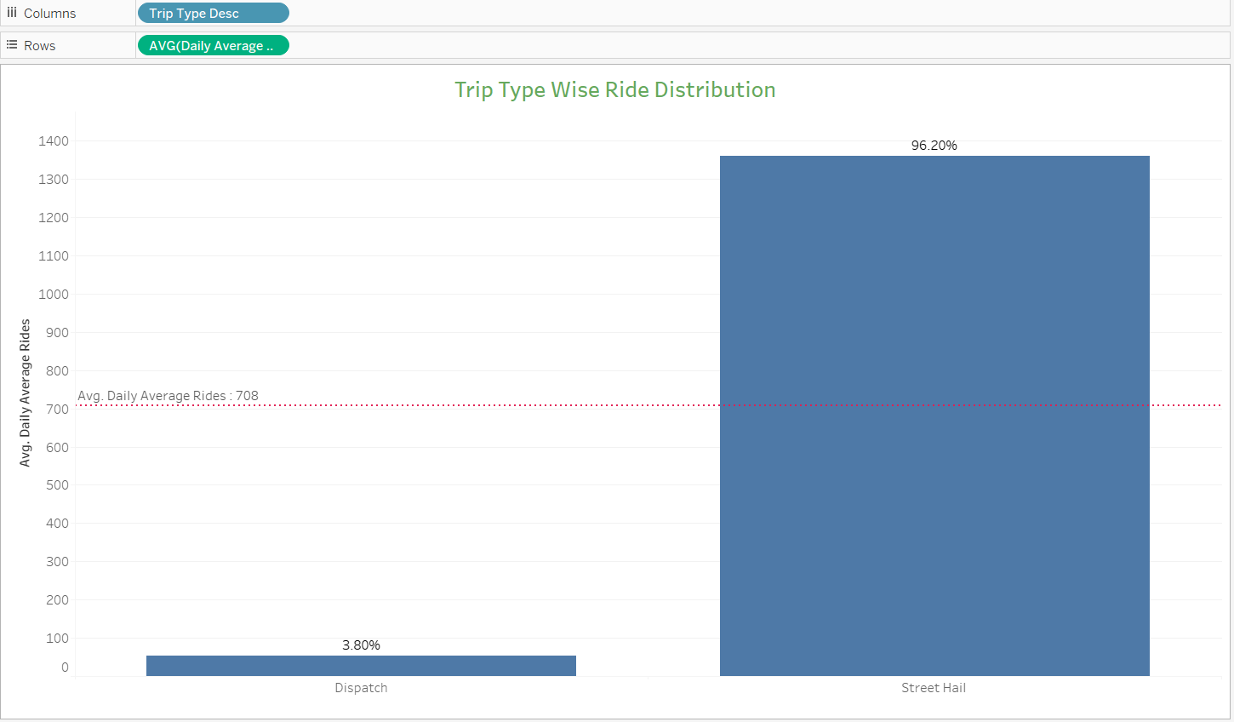
VISUALIZATION AND INSIGHTS
The average fare amount is $22.15.
With higher rates during the Early Mornings (3AM to 4AM), Mornings (9 AM to 10 AM) and in the Evenings (4PM to 5PM)
This Graph shows that 96% of bookings are made by street hail, confirming that ride sharing services are used more spontaneously than planned rides

Slide 10
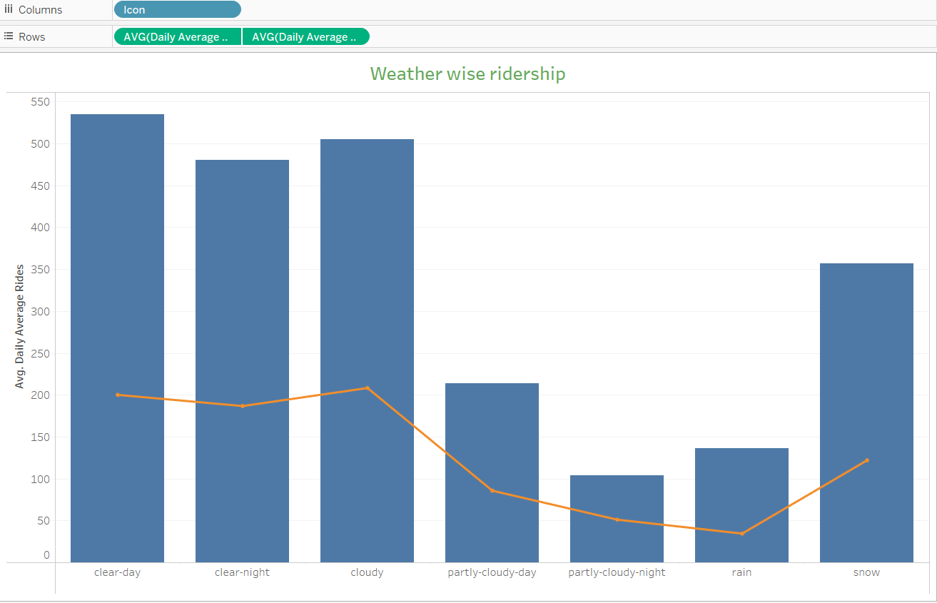
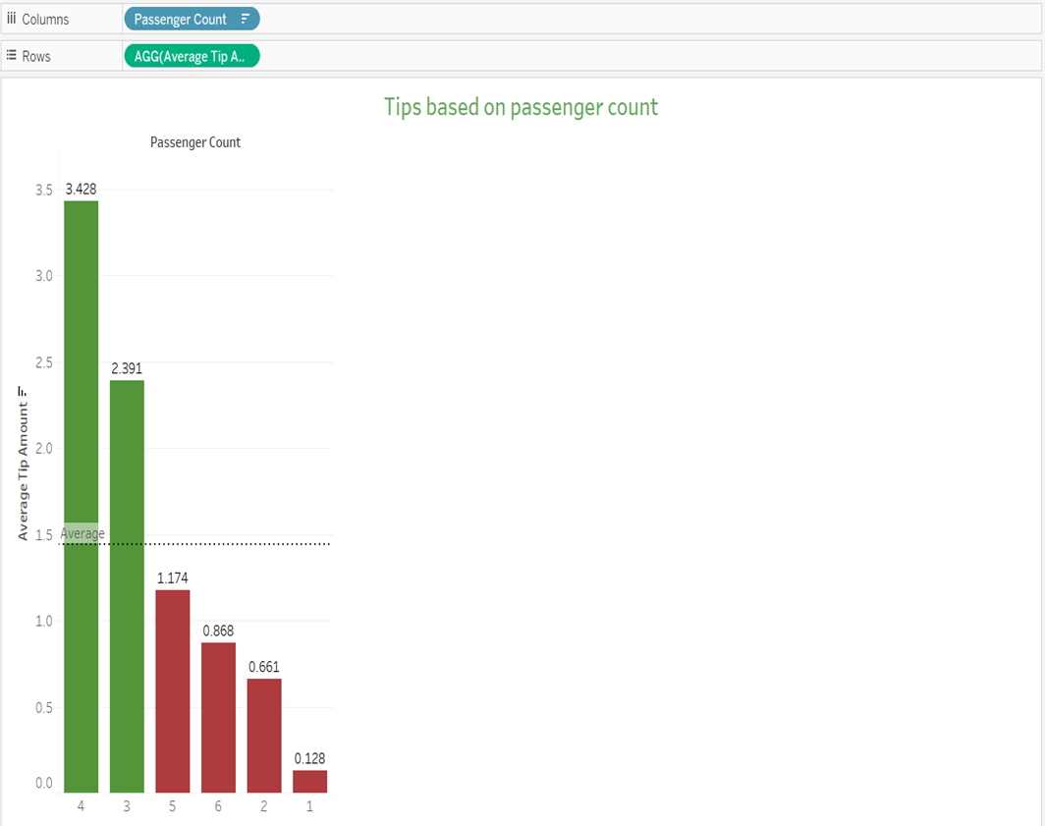
VISUALIZATION AND INSIGHTS
The graph clearly demonstrates that weather conditions like rain and partly cloudy(day/night) drastically reduces the number of people using taxis.
Average tip amount is highest when there are 4 passengers in the trip and the least when having a solo rider.

Slide 11
RECOMMENDATIONS
Weather-Responsive Pricing:
Recognizing the impact of weather on taxi usage, companies could implement dynamic pricing strategies that adjust fares based on current weather conditions.
Scheduled Maintenance:
The taxi company may schedule car maintenance activities when the weather conditions are partly cloudy (day/night) or when it rains. Additionally, maintenance may be scheduled during the early morning hours (3 AM to 5 AM) when the number of rides tends to be lower.
Promotion of Pre-booking:
Since most trips are made by street hail compared to pre-booking, taxi companies could implement discounts to encourage more pre-booked rides.

Slide 12
CHALLENGES, LEARNING AND FUTURE ENHANCEMENTS
Data Modeling: Designing an effective data model that can handle large volumes of data efficiently and support complex analytical queries.
Data Ingestion: Choosing the right methods and tools for ingesting data from various sources into the data warehouse, ensuring reliability, scalability, and data quality.
Data Transformation: Implementing ETL (Extract, Transform, Load) processes to transform raw data into a format suitable for analysis while considering factors like data consistency, performance.
Mobile App Integration: Introduce a user-friendly mobile app that incorporates real-time weather data.

Slide 13
Thank you

